Slide 1
Tracking Training
v. 6.26.17

Slide 2
What WIOA Requires us to Track
Under WIOA, we must track for each participant:
Whether or not they participated in a training program through ETP, and if so, the name of the ETP
The date training began
The type of training
OJT
Skill Upgrading
Entrepreneurial Training
ABE or ESL in Conjunction with Training
Customized Training
Other Occupational Skills Training
Remedial Training
Pre-requisite training
Registered Apprenticeship
Youth Occupational Skills Training
v. 6.26.17

Slide 3
What WIOA Requires us to Track (cont’d)
The program of study (for ETP programs only)
The CIP (Classification of Instructional Programs) code
The Occupational Skills Training Code
Whether or not the participant completed training and when they completed or withdrew
v. 6.26.17

Slide 4
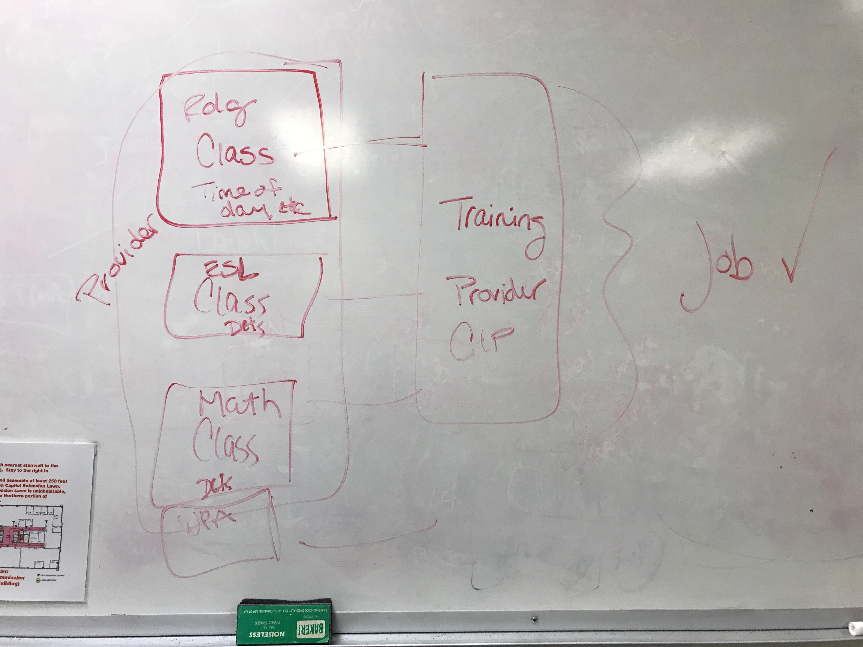
White Board

Slide 5
General Structure of Training Services in TEAMS
Class Participant
Class
Class Participant
Automatically assigns the training details to…
Class Participant
Training Service
(contains all the details)
Class
Manually assigned to
Class Participant
Class Participant
Class
Class Participant
Class Participant
v. 6.26.17

Slide 6
The Purpose of the Structure
Allows you to only add the services once
Allows you to maintain an individual training across multiple classes
ie a Welding training may be multiple classes
Allows you to track outcomes by participant
v. 6.26.17

Slide 7
Steps for Adding Training
Steps for a new training service
v. 6.26.17

Slide 8
Follow Instructions
It’s set up this way for a reason – follow instructions!

Slide 9
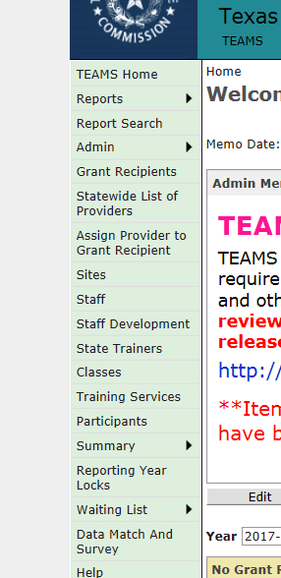
Step 1 – Menu selection
Select the new “training services” option from the TEAMS menu
v. 6.26.17

Slide 10
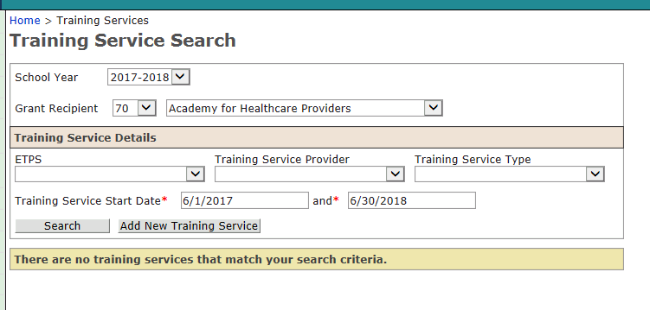
Step 2- Add New Service
v. 6.26.17

Slide 11
Important Note!
Each training service is a unique record, meaning, you may have 4 cohorts of welding training, you need to create a new record for each of these because everything related to search and tracking is related back to the start date
If you have two cohorts that have start dates on the same day, you can use the same record
v. 6.26.17

Slide 12
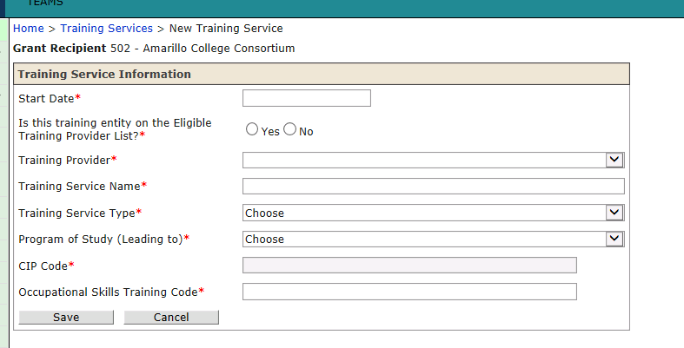
Step 3 – Add Start Date
v. 6.26.17

Slide 13
Step 4- Indicate if the Program is on the ETP List
v. 6.26.17

Slide 14
Step 5 - Select Provider
If provider is on the ETP list…
If the provider is not on the ETP list…
v. 6.26.17

Slide 15
Step 6 – Training Service Name
Should be indicative of the training, but also clear enough that you can select it from a list in the instance you have multiple training programs with similar (or the same) name
Example: Welding – Cohort 1
CNA – Summer Cohort
v. 6.26.17

Slide 16
Step 7 - Training Service Type
v. 6.26.17

Slide 17
Step 8 – Program of Study (leading to)
Only required for ETP programs (will be “greyed out” in final version)
Auto-populated for ETP programs
v. 6.26.17

Slide 18
Step 9 – Add CIP Code
Auto-pulls from national list
v. 6.26.17

Slide 19
Step 10 – Add Occupational Skills Training Code (O-NET*)
Auto-pulls from national list
v. 6.26.17

Slide 20
Step 11 – Assign Class to Training
Requires programs to set up the associated class first
Could be IET (meaning the class will track training and basic skills time) or just the training
v. 6.26.17

Slide 21
Step 11 – Assign Class (cont’d)
v. 6.26.17

Slide 22
Registered Participants
As participants are registered for a class associated with a particular class associated with this training record, they will appear here
v. 6.26.17

Slide 23
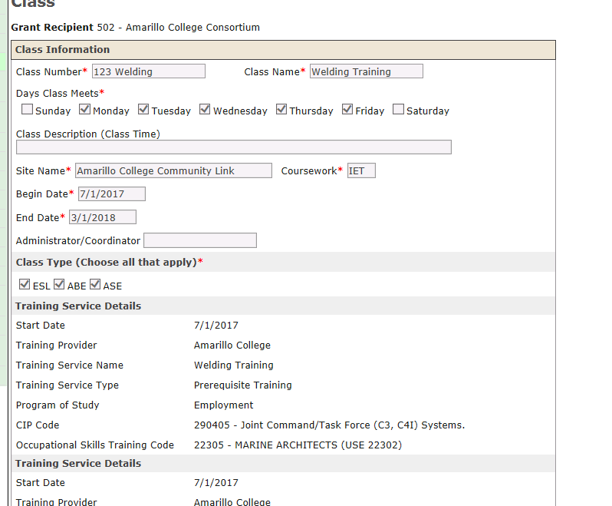
Associated trainings to Class
A class page will list all trainings associated with that class
Good for instances where you want to track different trainings for one class (ie CNA that also has medication aid associated with it)
v. 6.26.17

Slide 24
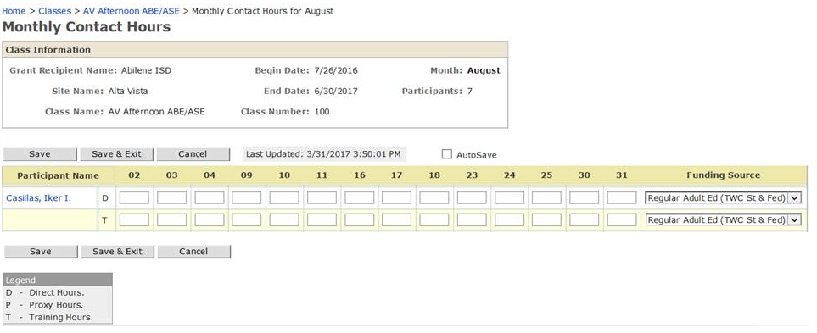
Step 12 – Track Participant Hours
Allows you to list different funding codes for D/T hours
v. 6.26.17

Slide 25
Step 12 – Track Participant Completion
From the main training record page, select “Edit” under “Training Status for Registered Participants”
v. 6.26.17

Slide 26
Step 12 – Track Participant Completion (cont’d)
v. 6.26.17

Slide 27
A Note on Participant Completion
Happens at the record stage instead of the class stage because a training may continue over the course of several classes – this doesn’t necessarily indicate that the participant has completed (or withdrawn) from the training
v. 6.26.17

Slide 28
Seeing Training at a Participant Level
v. 6.26.17

Slide 29
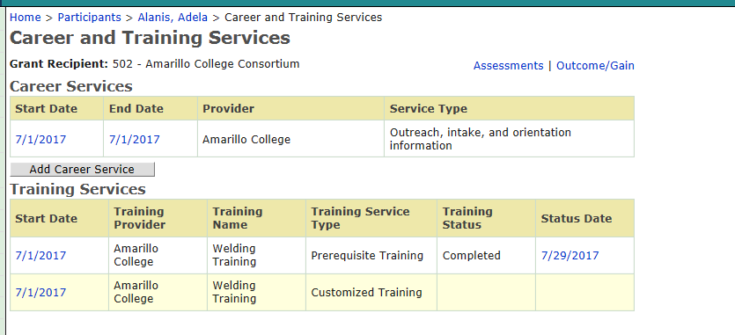
Seeing Training at a Participant Level (cont’d)
v. 6.26.17

Slide 30
General “Rules” For Training
All training needs to be tracked regardless of funding source
(Otherwise we won’t be able to report accurately to OCTAE)
Some sort of verification of attendance is necessary, but not necessarily a sign-in sheet
v. 6.26.17

